Slide 1
LAB – 11
Abstract classes, Exception handling

Slide 2
Task - 1
Sample Output
=== Sensor Data Analysis ===
Sensor: TempSensor_1 (Temperature)
Current Reading: 25.5°C
Status: Temperature is within safe range.
Sensor: TempSensor_2 (Temperature)
Current Reading: 105°C
Status: ALERT! Temperature out of range (0-100°C).
Sensor: PressureSensor_1 (Pressure)
Current Reading: 50 psi
Status: Pressure is within safe range.
Sensor: PressureSensor_2 (Pressure)
Current Reading: 250 psi
Status: ALERT! Pressure out of range (10-200 psi).
Create an abstract class Sensor with data members sensorName, currentReading, and a pure virtual function analyzeData().
Derive TemperatureSensor and PressureSensor to check if readings are within acceptable ranges (e.g., temperature between 0-100°C, pressure between 10-200 psi).
Display an alert if the reading exceeds limits. Use an array of pointers to simulate data from multiple sensors.

Slide 3
Task - 2
Create an abstract class DeliveryVehicle with data members vehicleID, distanceTravelled, and a pure virtual function calculateFuelCost().
Derive Truck and Motorcycle. Trucks consume 1 liter of fuel for every 5 km, motorcycles consume 1 liter for every 15 km.
If distanceTravelled exceeds 500 km, display "Maintenance Required." Use an array to process multiple vehicles.
Fuel price is 1.5$ per liter
DeliveryVehicle *d[4];
D[0] = new Truck(“T001”,600);
Sample Output
=== Vehicle Information ===
Truck T001 | Distance: 600 km | Fuel Cost: $180
Vehicle T001: Maintenance Required
Motorcycle M001 | Distance: 200 km | Fuel Cost: $20
Truck T002 | Distance: 450 km | Fuel Cost: $135
Motorcycle M002 | Distance: 550 km | Fuel Cost: $55
Vehicle M002: Maintenance Required

Slide 4
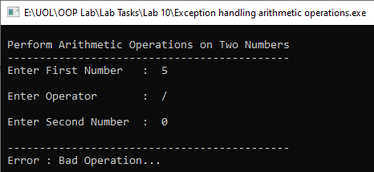
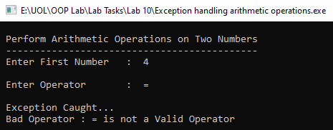
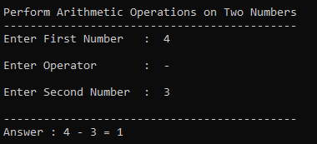
Task - 3
Write a C++ program to perform arithmetic operations (addition, subtraction, multiplication, and division) on two numbers. Use exception handling to:
Throw an exception if the user enters an invalid operator.
Throw an exception if the user attempts division by zero.
Display appropriate error messages for each exception.

Slide 5
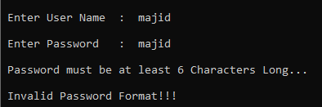
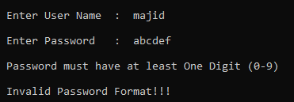
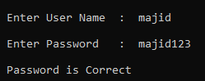
Task - 4
Write a C++ program to accept user name and password and throw an exception if the password has less than 6 characters or does not contain a digit.

